Slide 1

Managing Your Data: Metadata, Regex, and Git
Presenter Name

Slide 2
First, a Question
What kinds of data does your project encompass?
How much data is there?
What do users need to know about your data in order to use it effectively?

Slide 3

Metadata
Definition
Standards

Slide 4
Metadata: Definition and Purpose
“Data about data”
3 common components:
Content: Internal, information about the object.
Context: External, information about the object’s creation and existence.
Structure: Internal and External, about how the pieces of the object relate to one another, and how the object relates to other objects.
Purpose:
Visibility, discoverability, interoperability
Suggested reading: Introduction to Metadata, ed. Murtha Baca: https://www.getty.edu/publications/intrometadata/

Slide 5
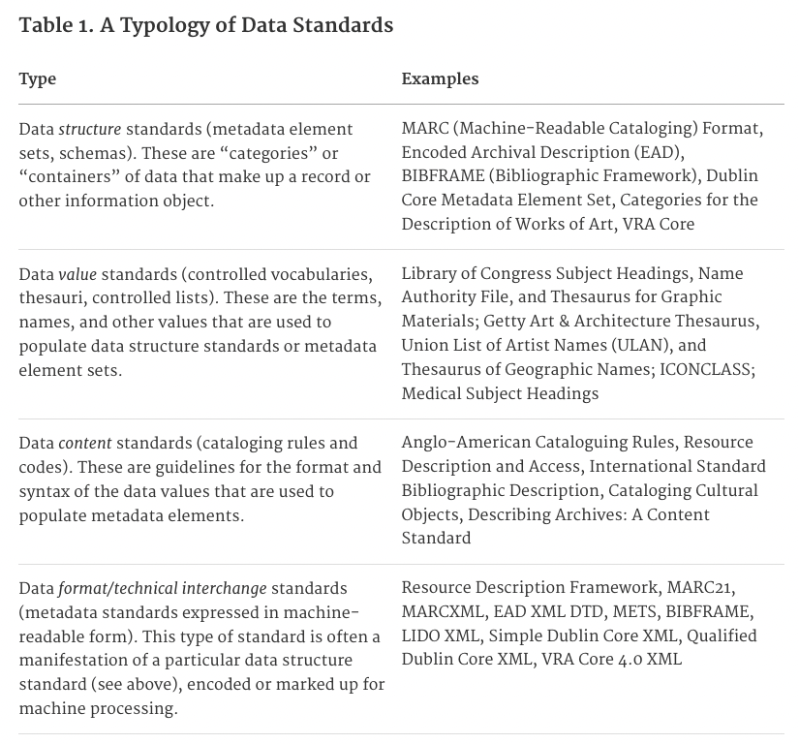
Metadata Standards

Slide 6
TEI Header: Purpose
The TEI Header is designed to provide metadata about the encoded document.
This section is not meant for public display (though, as we will learn, you can hide or display as much of your document as you like through XSLT).
The header includes information about both the original document that has been encoded and about the newly encoded document.
Consistency in the kinds of data presented in the TEI header allow for greater interoperability, and for new kinds of metadata records (e.g. Dublin Core) to be generated about your objects.

Slide 7
TEI Header: Necessary Components
File Description: <fileDesc>
This provides bibliographic information about the file itself and the sources that were used in its creation. The data here should be complete enough to allow an outside user (e.g., a librarian) to construct a metadata record for the document.
Each <fileDesc> requires:
Title Statement
Includes the title <title>, an author <author> and a responsibility statement <respStmt> including both a responsibility <resp> tag and a name <name> tag that describe who is responsible for the encoding/editing of the document. Multiple authors or responsibility statements may be in a single title statement.
Publication Statement
Describes the publisher of the present file. It can include the publisher’s name and address or other contact information, as well as licensing information for using and reproducing the file.
Source Description
A description of the source from which the electronic file has been derived, nested within a <bibl> tag.

Slide 8
File Description: Optional Components
Edition Statement <editionStmt>
If you are publishing multiple editions of your file, you should use this to keep them distinct.
Extent <extent>
Includes data about the size and scope of the edition, whether in pages, gigabytes, or some other unit of measure.
Notes Statement <notesStmt>
This field allows for the inclusion of additional notes on the creation of the file.
Series Statement <seriesStmt>
If your edition belongs to an ongoing series, this is where that series would be indicated.

Slide 9
Other TEI Header Components
In addition to a File Description, there are several other header elements that can be included, depending on the needs of your project.
Encoding Description <encodingDesc>
This section explains what decisions were made during the encoding process and describes the relationship between the file and its source.
This can be quite complex, and often serves as a kind of editorial methodological statement.
Text Profile <profileDesc>
This contains metadata about the non-bibliographic elements of the text, including language usage, notes on participants in the text, descriptions of the text’s purpose and creation, abstracts, etc.
Xeno Data <xenoData>
Data from schema or metadata structures other than the TEI (e.g., Library of Congress records, Dublin Core metadata, MARC records)
Revision History <revisionDesc>
A documenting of all changes made to the electronic edition and the parties responsible for those changes.

Slide 10
Textual Metadata
Linked Open Data
Controlled vocabularies
Virtual International Authority File: person names, linked to works
Getty Vocabularies (Art and Architecture Thesaurus, geographic names, cultural objects, etc.)
Library of Congress authority files (subjects, names, titles), relator codes (roles), and language codes

Slide 11

Git, GitHub, and Version Control (Part 1)

Slide 12
Some Definitions
Version control: a system for managing changes to data.
Distributed version control: a system of version control in which the complete history of the data is mirrored on each user’s computer.
Git: the most commonly used distributed version control system.
Github: a hosting service for Git.

Slide 13
Getting Started with Git
Go to https://github.com
Sign up for a free GitHub account
Download GitHub Desktop from https://desktop.github.com/
Install GitHub Desktop and log in.

Slide 14
Cloning a Repository
Go to the following URL: https://github.com/leliebe/P4H
Click the green “Code” button. Copy the HTTPS URL (here, it’s the same, but it may not always be!)
Go back to GitHub Desktop.
Click the “Current Repository” dropdown in the top left.
Click “Add” then “Clone Repository”
Navigate to the URL tab, paste the URL, choose where you want the local path to be (NOTE: This should be on your hard drive, not in the cloud), then click “Clone”

Slide 15

Break Time!
10 minutes

Slide 16

Regular Expressions

Slide 17
Regular Expressions
Regex is a sequence of characters that specifies search parameters within a text.
When working with dirty OCR, it can be a very effective (if a bit brute force) method of cleaning a lot of text quickly.
Regex Tutorial: https://regexone.com/
Regex Testing: https://regex101.com/
Regex Cheat Sheet: https://www.rexegg.com/regex-quickstart.html

Slide 18
A Practical Example
Aphra Behn’s The Amorous Prince (full text from the Internet Archive)
Cleaning a poorly OCR’d text
Step 1: Fixing the “&”
context clues suggest that this is a misreading of “ct”
Step 2: Fixing the “long S”
Step 3: Fixing extra line spacing
Find \n\n
Replace \n

Slide 19
A Practical Example (Continued)
Step 4: Getting rid of strange character strings:
Identify characters that should not be in the document. Add them to an array, replace with nothing
[■¥*~^•{]
Step 5: Erasing sections of bad OCR
This, it’s usually best to do by hand if you have large sections (e.g., empty pages that have been misread)
Identify patterns of error
<? becomes ?
Isabella is often “Ijabella” or “Ifabella”. I.abella will find both.

Slide 20
Tagging Speakers and Speech Blocks
Find all the speakers
\n([A-Z]...\.)
The parentheses define a group. We will call this group in the replace command with \1
</sp>\n<sp>\n\t<speaker>\1</speaker>
This will add speech block and speaker tags around all of the speakers. We’ll have a little cleanup to do, but not nearly as much as if we were doing this by hand.
We’ll want to repeat this query with one less period (for characters whose names are abbreviated to three letters)

Slide 21
Tagging Lines
Add opening <l> tags after each </speaker>
Find: </speaker>
Replace: </speaker>\n\t<l>
Select all text after “Act I. SCENE I.”
Find: \s\n
The \s is here because this document seems to always add a space at the end of each line.
Replace: </l>\n\t<l>
Add closing line tags before each </sp>
Find: </sp>
Replace: </l>\n</sp>

Slide 22

Git, GitHub, and Version Control (Part 2)

Slide 23
Pushing to a Repo
Save your RegEx work on tagging the Behn play. Use this structure: “LastName_BehnAP.xml”
Move this file into the “RegEx” folder under the “StudentExercises” folder inside the GitHub repo.
You should see your changes reflected in GitHub Desktop.
If your changes seem correct and complete, add a summary (and a description, if desired).
Click “Commit to main”
Click “Push origin”

